Slide 1
Unit 203: Electrical installations technology
Drawings

Slide 2
Types of drawings:
as fitted drawings
circuit diagrams
block diagrams
schematics
wiring diagrams
bar charts.

Slide 3
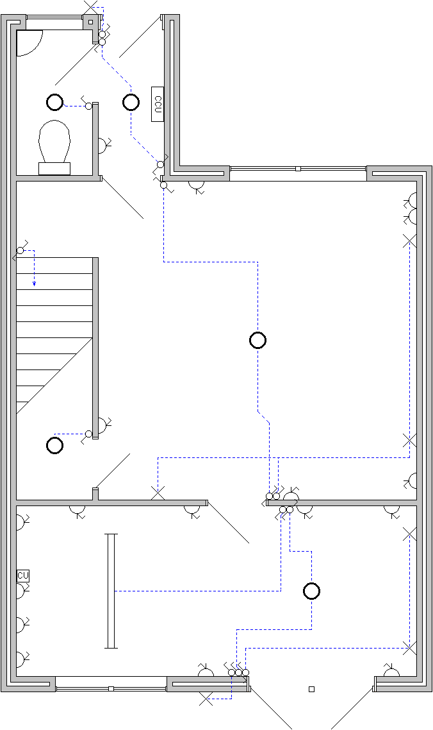
Architectural plans

Slide 4
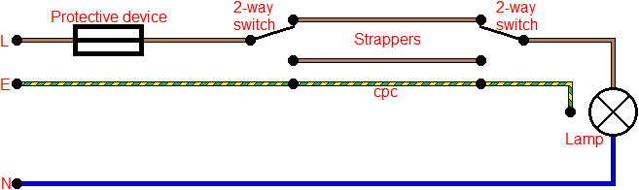
Circuit diagrams

Slide 5
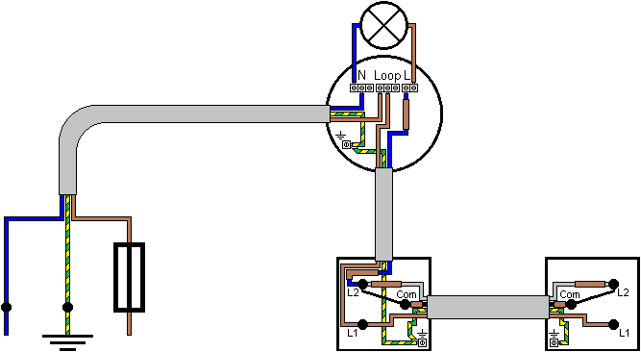
Wiring diagrams

Slide 6

Block diagrams

Slide 7
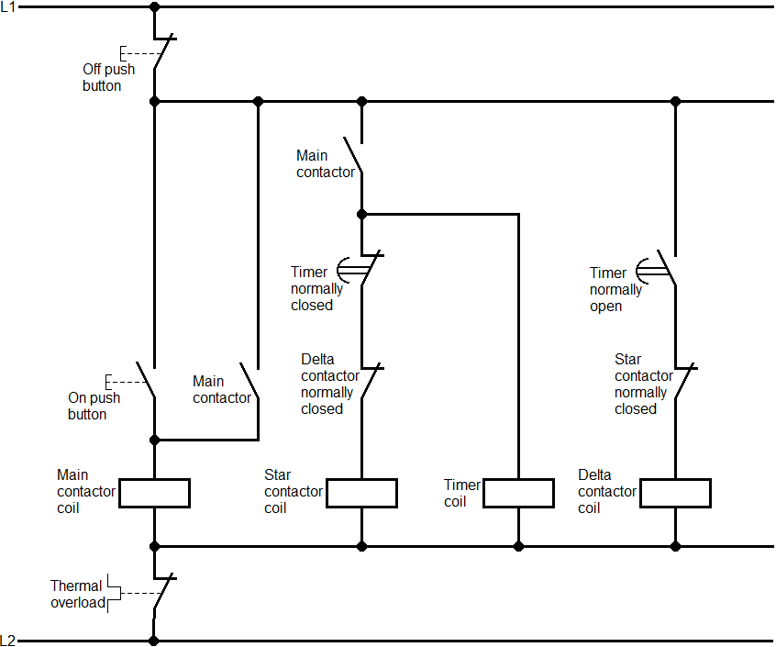
Schematic diagrams

Slide 8
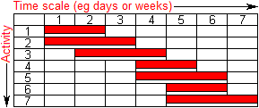
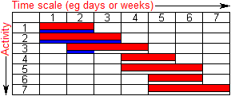
Bar charts

Slide 9
Unit 203: Electrical installations technology
The End

